Slide 1
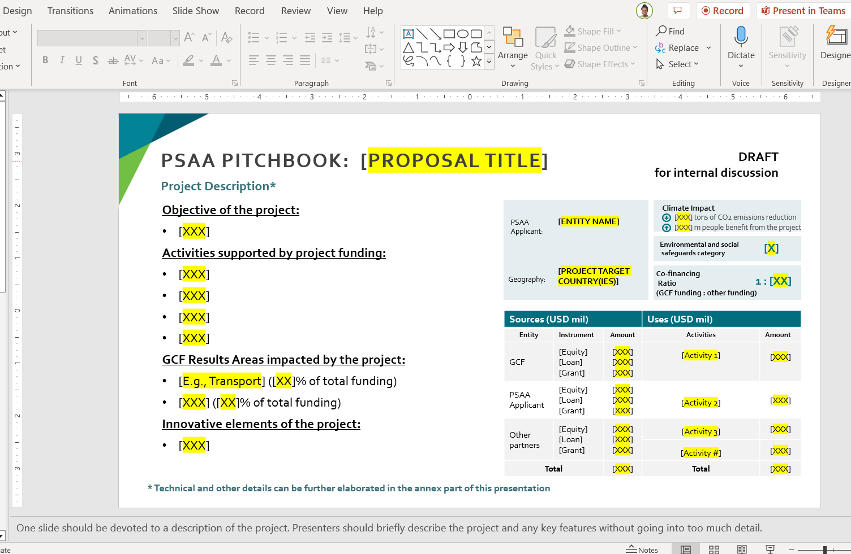
INSTRUCTIONS
Please read the notes for further guidance on each slide.
The diagram on slide 6 is a template for reference only. Please replace with project specific diagram.
Annexes are optional (You may refer to slide 10 as an example for an annex).
Maximum number of slides is 10. Submissions may not be considered if they exceed this limit.

Slide 2
Information:
PSAA Accreditation & PROJECT Scope
The proposed project will be commensurate with the applicant’s track record.
The approved accreditation scope will specify the
Project/programme size
  Micro, Small, Medium, Large
Environmental and social risk category
  C/I-3 (minimal to no risk)
  B/I-2 (limited adverse risk)
  A/I-1 (significant risk not eligible)
Financial instrument(s) requested from GCF
  Grants, Loans, Guarantees, Equity
Financing modalities
  Project management
  Grant award and/or funding allocation mechanisms
  On-lending and/or blending (loan, guarantee, equity)
Accreditation for financing modalities is based on the “instrument the applicant will deploy themselves”.
Accreditation for project management is required for all applicants.
Notes:
The financing modalities include
Project management: ability to identify, formulate, appraise, monitor and evaluate projects or programmes;
Grant award and or funding allocation mechanism: ability to develop transparent eligibility criteria, evaluation process for grant award decision-making; and good standing with regard to multilateral funding.;
On-lending and or blending (for loans, equity and/or guarantees): On-lend (including directly to borrowers or other financial institutions that would thereafter on-lend), blend, undertake equity investments; and or provide guarantees; existing arrangements and capacities for on-lending and blending with resources from other international or multilateral sources.
For the proposed project, Applicants will confirm:
Instrument GCF will be requested to provide to the applicant;
The applicant itself will deploy; and or
Will be deployed by others for the implementation of the project/programme.

Slide 3
PSAA PITCHBOOK
[PROPOSAL TITLE]
[ENTITY NAME]
[DATE OF THE PRESENTATION]

Slide 4
Entity background
Suggested information includes, but is not limited to:
Year of establishment
Institutional Capacity
  Staffing
  Operating Budget
  Internal controls
  ESMS
  Gender
Track Record – Information on previous projects/programmes that demonstrate sufficient ability to design, implement and manage the proposal.
  Size
  E&S Risk Category
  Financial instruments
  Financial Modalities
Relevant background information

Slide 5
PSAA Pitchbook: [Proposal title]
Project/Programme Description
Objective of the project:
[XXX]
Activities supported by project funding:
[XXX]
[XXX]
[XXX]
[XXX]
Countries of Operation:
[E.g., Country A – HQ]
[E.g., Country B – Operational HQ]
GCF Results Areas impacted by the project:
[E.g., Transport] ([XX]% of total funding)
[XXX] ([XX]% of total funding)
Innovative elements of the project:
[XXX]
PSAA Applicant:
[ENTITY LEGAL NAME]
Climate Impact
[XXX] tons of CO2 emissions reduction
Incorporation
Date:
[Entity Incorporation Date]
[XXX] m people benefit from the project
Environmental and social
safeguards category
[X]
Incorporation
Location:
[Entity Incorporation Location]
Co-financing
Ratio
(GCF funding : other funding)
1 : [XX]
Headquarters Location:
[HQ Location Country]
Entity Operating Budget/Assets:
[XXX in USD]
Project
Geography:
[PROJECT TARGET COUNTRY(IES)]
Sources (USD mil) |  |  | Uses (USD mil)
Entity | Instrument | Amount | Activities | Amount
GCF | [Equity] [Loan] [Grant] | [XXX] [XXX] [XXX] | [Activity 1] | [XXX]
PSAA Applicant | [Equity] [Loan] [Grant] | [XXX] [XXX] [XXX] | [Activity 2] | [XXX]
Other partners | [Equity] [Loan] [Grant] | [XXX] [XXX] [XXX] | [Activity 3] | [XXX]
 |  |  | [Activity #] | [XXX]
Total |  | [XXX] | Total | [XXX]
* Technical and other details can be further elaborated in the annex part of this presentation
Notes:
Introduce the proposal with a brief overview of the orignation efforts.
One slide should be devoted to a description of the project. Presenters should briefly describe the project and any key features without going into too much detail.
It must include:
Objective
Activities
Results areas: http://www.greenclimate.fund/themes-result-areas
Sources and uses of funds
Impact estimate (As applicable, tCO2eq for mitigation, beneficiaries for adaptation, both for cross-cutting proposals)
ESS category
Results Areas:
Health, food, and water security (A1)
Livelihoods of people and communities (A2)
Energy generation and access (A3)
Transport (A4)
Infrastructure and built environment (A5)
Ecosystems and ecosystems services (A6)
Buildings, cities, industries and appliances (A7)
Forests and land use (A8)
Innovative elements of the proposal are not limited to and can include: 1) technology development and transfer, 2) financial structure, 3) new methodology or indigenous knowledge, and 4)scaling and replicating

Slide 6
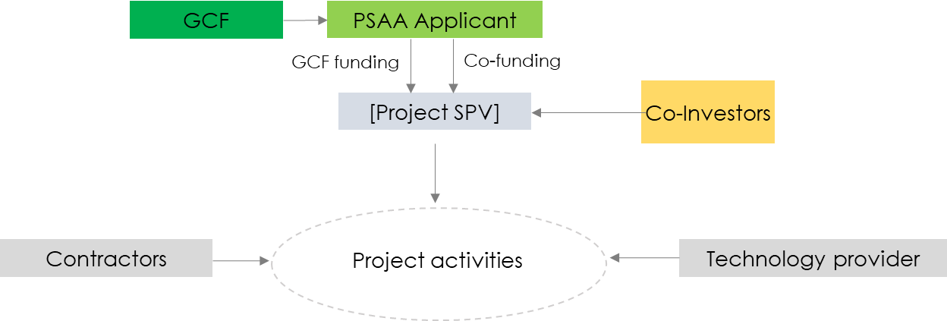
PSAA PITCHBOOK: [PROPOSAL TITLE]
Indicative flow of funds and participants/stakeholders chart*
USD [XX]
USD [XX]
USD [XX]
*
The illustration above provides an indicative example of a funding structure. The actual funding structure should be based on the specific situation applicable to the project. Funding amounts, inflows and reflows of funds, legal entity receiving GCF funding, co-funding partners and other participants/stakeholders involved in, or relevant for, the project development and operation should be clearly identified.
Notes:
The image "indicative flow of funds and participants/stakeholders chart“ is a template. Please delete and replace with a digram of the proposed PSAA proposal.
The proposal specifc image produced does not need to reflect all the elements included in the example provided.
One slide should be devoted to a description of the project implementation arrangements. Presenters should briefly describe the project and any key features without going into too much detail.
It must include:
The actual funding structure should be based on the specific situation applicable to the project. Funding amounts, inflows and reflows of funds, legal entity receiving GCF funding, co-funding partners and other participants/stakeholders involved in, or relevant for, the project development and operation should be clearly identified.

Slide 7
PSAA PITCHBOOK: [PROPOSAL TITLE]
Climate change problem and solution
[Please use this slide to answer the following questions in the table. This text can be deleted prior to submission.]
What is the climate change problem facing the targeted country(ies) that this proposal hopes to address?
How will the project’s proposed activities specifically contribute to addressing the climate change problem?
What will be the mitigation and or adaptation impact?
Why are GCF involvement and funding needed?
Notes:
Please use this slide to describe the project/programme rationale, including the climate change problem, how will it be addressed by the project activities, what will be the mitigation and or adaptation impact, and why GCF involvement and funding are needed.
For further information you may refer to: http://www.greenclimate.fund/document/principles-demonstrating-impact-potential-gcf-supported-activities

Slide 8
PSAA PITCHBOOK: [PROPOSAL TITLE]
Country needs and country ownership
[Please use this slide to answer the following questions in the table. This text can be deleted prior to submission.]
Paradigm Shift | (How can the proposed project catalyze impact beyond a one-off investment?)
Country Ownership | (Does the proposed project align with nationally determined contributions (NDCs), relevant national plans indicator, and/or enabling policy and institutional frameworks? How does the project help to achieve national development goals and/or climate change policies? To which degree is the project supported by a country's institutional framework?)
Notes:
Please use this slide to identify country needs and country ownership
For further information you may refer to: http://www.greenclimate.fund/document/investment-criteria-indicators
For more information on how GCF appraised projects, you may refer to: appraisal guidance.

Slide 10
Annexes (optional)
Economic and financial parameters – Recommended for fund applicants
Indicative project development timespan in years: [XX] Total investment amount to develop (USD): [XX]
Indicative operational (after the development) timespan of the project in years: [XX]
Indicative annual operational revenue (USD): [XX]
Indicative annual operational costs (USD): [XX]
IRR: [XXX]%, NPV (@discount rate): [XXX] (@[XXX] %)
Grant funding / total funding ratio: [XX]%, Debt/ Equity ratio: [X]
Indicative GCF funding parameters: [e.g. size & interest rate of a loan /parameters of equity and other relevant items]
Indicative funding parameters for co-funding partners: [e.g. size & interest rate of a loan /parameters of equity etc]
Other relevant considerations: [XXX]
[Brief outline why GCF funding is needed and how GCF concessionality will reach people benefiting from the project’s outputs and outcomes]
[Brief outline how, after the project implementation, other similar projects may be developed going forward without GCF funding concessionality]
Notes:
This slide is optional.
Please use this slide to identify economic and financial parameters of the project.

